Slide 1
CAPSTONE PROJECT
Employee Salary
Prediction
Presented By: Akash Kumar Bareilly College, Bareilly – Department of Computer Application

Slide 2
OUTLINE
Problem Statement
System Development Approach (Technology Used)
Algorithm & Deployment (Step by Step Procedure)
Result
Conclusion
Future Scope(Optional)
References

Slide 3
Problem Statement :
Employee attrition is a critical issue in human resource management that affects the operational and financial efficiency of organizations. Predicting whether an employee is likely to leave helps HR departments proactively retain valuable talent. This project aims to identify key factors influencing attrition and build a machine learning model that can accurately predict if an employee is at risk of leaving based on historical data.

Slide 4
System Approach
System Requirements Hardware:
Processor: Intel Core i3 (i5+ recommended) RAM: 4 GB+ (8 GB+ recommended)
Storage: 500 MB free disk space
OS: Windows 10+, macOS 10.13+, Linux
Software:
Programming Language: Python 3.8+
Development Environment: Jupyter Notebook, VS Code, or PyCharm
Key Libraries for Model Development:
pandas: Data manipulation and analysis.
numpy: Efficient numerical operations.
scikit-learn: ML algorithms, preprocessing, evaluation.
matplotlib: Data visualization and plotting.
xgboost: High-performance gradient boosting.
joblib: Model persistence (saving/loading).

Slide 5
Algorithm & Deployment
Step-by-Step Procedure:
Data Loading: Import dataset (CSV file with salary and attrition data).
Data Cleaning: Handle missing values and inspect data types.
Feature Encoding: Convert categorical columns like gender, education level, and job title into numeric form.
Train-Test Split: Divide the dataset into training and test sets.
Model Training: Apply a classifier (e.g., Decision Tree or Logistic Regression).
Prediction & Evaluation: Predict attrition and evaluate using accuracy score and confusion matrix.
Deployment (Optional): Deploy using Streamlit or Flask (for presentation).

Slide 6
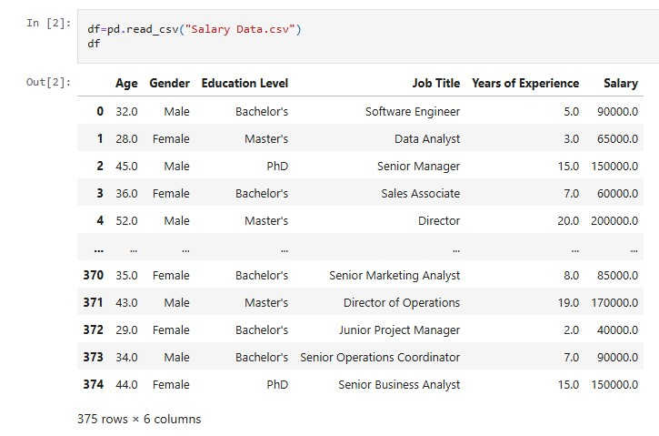
Result 1

Slide 7
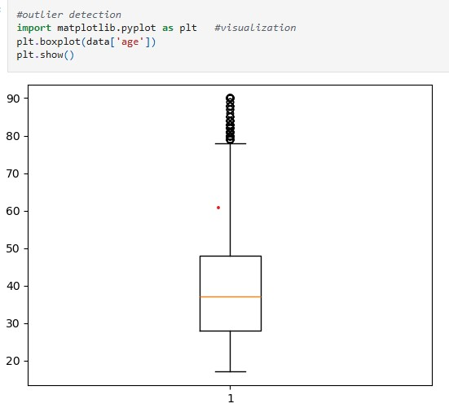
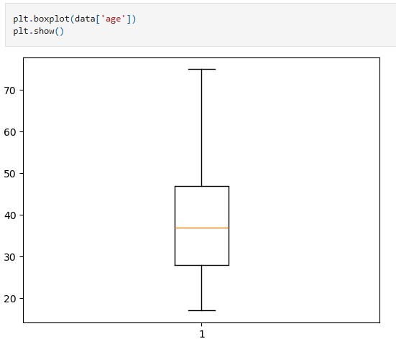
Result 2 ,3

Slide 8
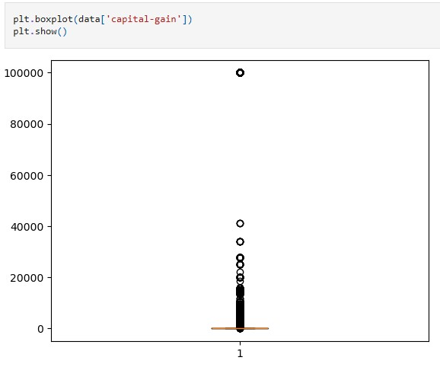
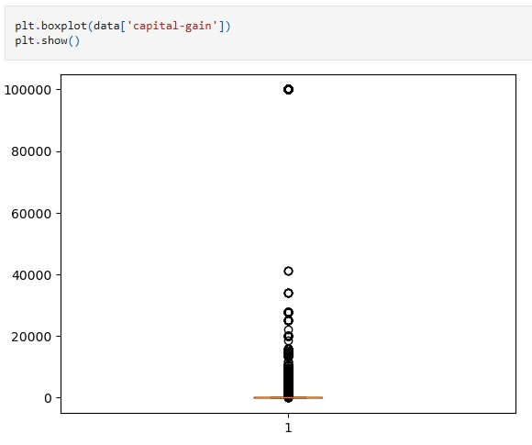
Result 4,5

Slide 9
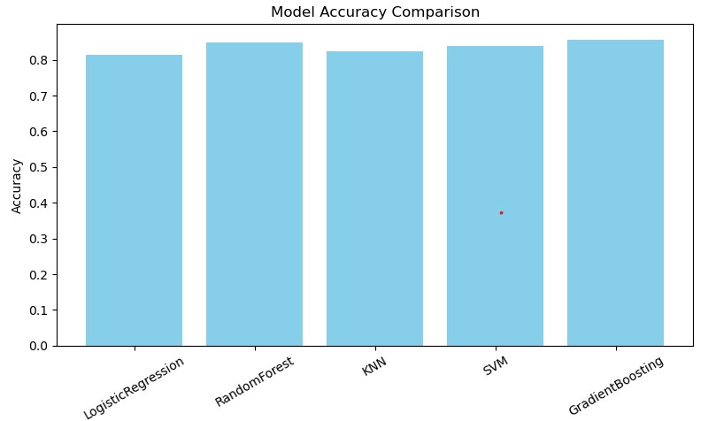
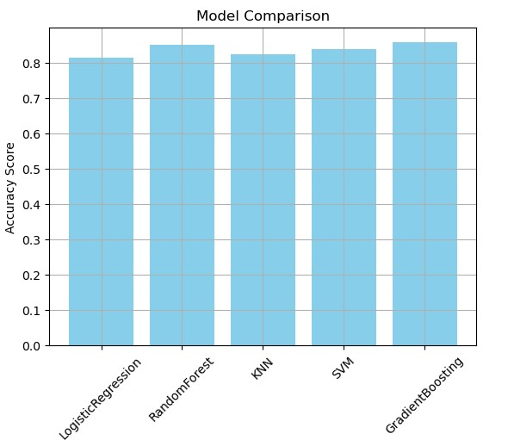
Result 6 ,7
Github Repository: https://github.com/akdev63063/Employee_Salary_ Prediction.git

Slide 10
Conclusion
This project successfully demonstrates how machine learning models can be leveraged to predict employee attrition with decent accuracy. The use of simple features like salary, job title, and education level provided insightful patterns. Challenges included limited data diversity and class imbalance. Future models can include more attributes like performance scores or work experience to improve accuracy.

Slide 11
Future scope
Enhanced Feature Engineering Integrate company size, industry, location, and performance metrics for a more comprehensive model
Hyperparameter Tuning Utilize techniques like GridSearchCV to fine-tune Random Forest and XGBoost for peak accuracy
Web Application Deployment Develop a user-friendly web interface (e.g., Flask/Django) for instant salary predictions.
Model Interpretability Implement SHAP (SHapley Additive exPlanations) to clarify which factors influence salary predictions most.
Integrate with a live HR dashboard
Use ensemble models like Random Forest or XGBoost
Expand dataset across industries and countries

Slide 12
References
Kaggle Dataset (if used)
scikit-learn documentation
HR analytics research papers
Machine Learning with Python (Sebastian Raschka)
Dataset Source: Kaggle - Salary Data. Available at: https://www.kaggle.com/datasets/rkiattisak/salaly-prediction-for-beginer
Scikit-learn Documentation: Pedregosa, F., Varoquaux, G., et al. (2011). Scikit-learn: Machine learning in Python. Journal of Machine Learning Research, 12(Oct), 2825-2830
Pandas Documentation: The pandas development team. (2020). pandas-dev/pandas: Pandas. Zenodo. https://doi.org/10.5281/zenodo.3509134
------ thank You -------

